Slide 1
Tweeting from Left to Right: Echo Chambers in Delhi
Election
Department of Computer Science and Engineering
Bharati Vidyapeeth’s College of Engineering, New Delhi, India
Supervised by :
Dr Vedika Gupta (Assistant Professor)

Slide 2
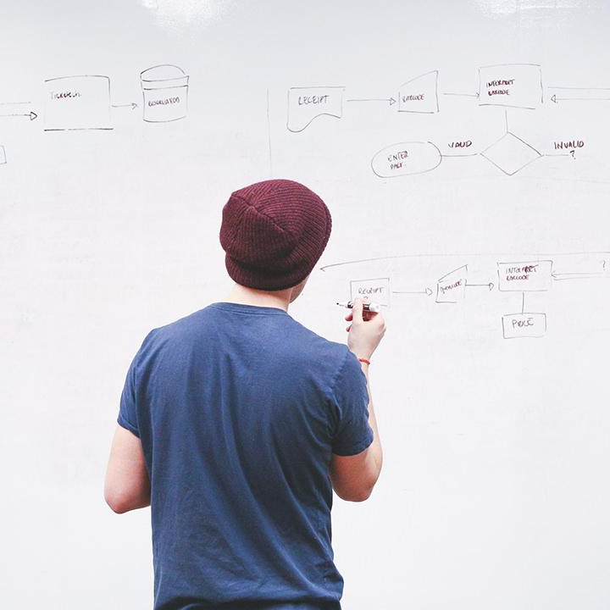
HELLO!
Adarsh Kumar
CSE-Evening
Rohan Arora
CSE-Evening
Piyush Katariya
CSE-Evening

Slide 3
Table of Content
Motivation
Introduction
Review of literature
About Dataset
Generic Methodology
5.1 Identifying Eco-Chambers.
5.2 Comparison between various clustering algorithms.
5.3 Analyzing Tolerance level of people in each Eco-Chamber.
5.4 Analyzing Influencing power of each Eco-Chamber.
Analysis of Results
Conclusion
Future Scope
References

Slide 4
Motivation for the work
1.
Echo chambers can be tricky to recognize, especially if you’re in one.
Do they tend to only give one perspective on an issue?
Is that viewpoint mainly supported by rumor or incomplete evidence?
Are facts ignored whenever they go against that viewpoint?
Misconceptions on social media Says that “Echo chambers are dangerous and we should avoid this trap”

Slide 5
Introduction
2.
Echo chamber - An environment where a person encounters opinions that reflect and reinforce their own.
Echo chambers can happen anywhere where information is exchanged.
Echo chambers have emerged as an issue of concern in the political discourse of democratic countries.
Study the degree to which echo chambers exist in political discourse on Twitter, and how they are structured.
Echo chambers are prevalent on Twitter.

Slide 6
3.
Related Work
Title | Methodology | Results Obtained
Political Discourse on Social Media: Echo Chambers, Gatekeepers, and Price of Bipartisanship, 2018 | Finds the Twitter users that are exposed to political opinions that agree with their own, bridge echo chambers by “price of bipartisanship” and “gatekeepers” | Predicted “partisans” and “gatekeepers” from social media and content features. Found that partisan easy to identify, while gatekeepers proves more challenging.
Falling into the Echo Chamber: The Italian Vaccination Debate on Twitter, 2020 | Examines Italy vaccination debate on Twitter by identifying vaccination sceptics and advocates in their echo chambers, clusters supporters with content based classifier. | Identified supporters of vaccinators on content-based classifier with 95% cross validation accuracy.
Populism and Social Media: A comparative analysis of populists’ shared content and networks on Facebook, 2021 | The analysis is carried out on two levels: a) classification of 17 official Facebook pages of main populist leaders/parties in Europe. b) network analysis of 17 populist actors that share their post for parliament elections. | Identified main disseminators in their networks as their party colleagues, political fan groups that support them or oppose their political rival by K-fold clustering.

Slide 7
About Dataset
4.
The dataset is taken from kaggle : https://www.kaggle.com/nitinmaheshtiwari/2020-delhi-election-tweets-dataset.
Dataset contains tweets from 2020 Delhi Election time.
Two major political parties covered are: Bharatiya Janata Party (BJP) and Aam Aadmi Party (AAP).
This dataset contains user tweets along with the userID, date and time of creation and a sentiment score.
Attributes of this dataset:
created_at : Time and Date of tweet creation.
tweet : Contains tweets from different users.
user_id : UserID of the user tweeting the Tweet.
sent : Contains sentiment score of every tweet i.e whether written in favour of the party or in against of the party.
Dataset contains around 1M+ tweets for both the political parties.

Slide 8
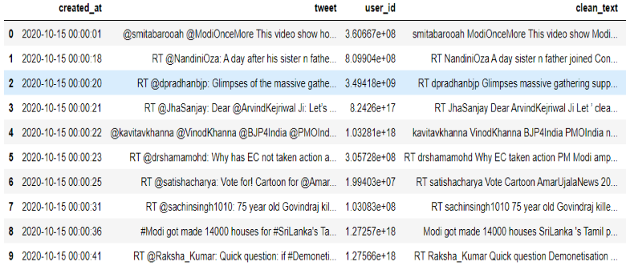
Snapshot of Dataset after Preprocessing
Fig .1 Dataset after preprocessing

Slide 9
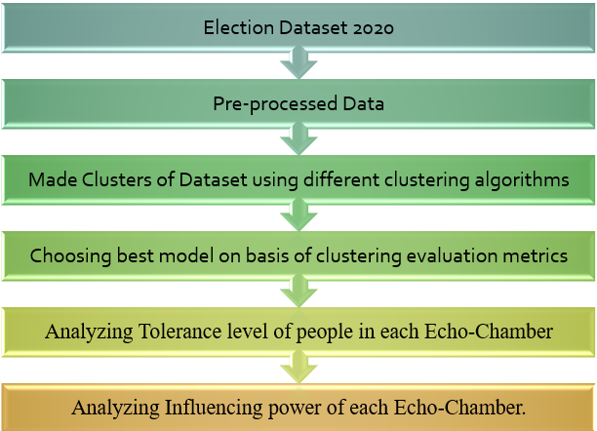
Methodology
5.
Data Preprocessing:
Removing Stop Words and Punctuation.
Removing hyperlinks and tags.
Lemmatizing the corpus using POS tags using NLTK Library.
Making Clusters out of the dataset using different clustering algorithms:
DB-SCAN Clustering Algorithm
K-Means Clustering Algorithm
Mean-Shift Clustering Algorithm
Using visual representation for Analyzing Tolerance level of people in each Echo-Chamber.
Using visual representation for Analyzing Influencing power of each Echo-Chamber.
Fig .2 Methodology

Slide 10
Identifying Eco-Chambers
5.1
Different Clustering Algorithms used:
DB-SCAN Clustering Algorithm
K-Means Clustering Algorithm
Mean-Shift Clustering Algorithm
2. For Feature Extraction we used,
TF-IDF Vectorizer
Countvectorizer
With different number of features and n-grams ranges.
3. Finally we used, TF-IDF Vectorizer with max-features as 200 and n-gram range as (1,2).
4. We created 4 Clusters out of Dataset naming:
BJP Supporters
BJP Opposition
AAP Supporters
AAP Opposition

Slide 11
5.2 Comparison between various clustering algorithms
Clustering Algorithms | Mean Shift | DBSCAN | K Means
silhouette_score | 0.681993869 | 0.734424408 | 0.933227692
adjusted_rand_score | 1 | 0.975376174 | 1
davies_bouldin_score | 0.437564008 | 1.491471966 | 0.094045005
mutual_info_score | 1.386294361 | 1.361653759 | 1.386294361
calinski_harabasz_score | 1210.089914 | 2023.003291 | 141224.1733
Table .1 Comparison between different clustering algorithms

Slide 12
Analyzing Tolerance level of people
5.3
The tolerance level of people indicates the upper limit of how many opposing thoughts and ideologies a person can tolerate.
Based on the above definition, we categorized tolerance into 3 levels:
High Tolerance Level
Moderate Tolerance Level
Low Tolerance Level
We calculated a Fluctuating Factor for each user as,
Fluctuating Factor = Number of times user fluctuated between different eco-chambers
Total number of tweets
The tolerance level of user ∝ 1 _
Fluctuating Factor of user

Slide 13
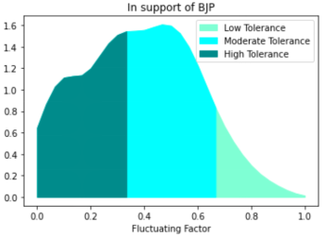
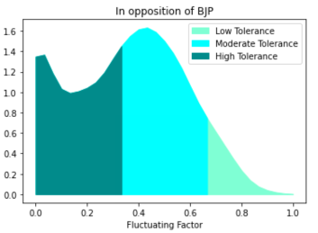
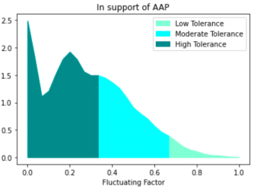
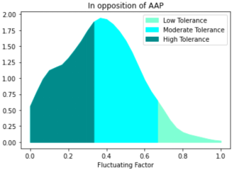
Results for Tolerance Analysis
Figure: 2) Probability Density of people with each level of tolerance in support of BJP
3) Probability Density of people with each level of tolerance in opposition of BJP
4) Probability Density of people with each level of tolerance in support of AAP
5) Probability Density of people with each level of tolerance in opposition of AAP
Fig .2
Fig .3
Fig .4
Fig .5

Slide 14
Analyzing Influence of each Echo Chamber
5.4
The influence of an echo chamber can be defined as its power to make other people agree with its opinions and ideologies.
An echo chamber with high influencing power can attract new users to join as well as retain its existing users.
Based on previous data of each user, we tried to predict his future trend of tweets using RNN.We generated the data for 30 days using Simple RNN and based on that data, we calculated the number of people joining a particular echo chamber and the number of people leaving that echo chamber.
For each echo chamber:
for each day in 30 days :
plot number of people joined - number of people left
Influence power of echo-chamber = slope of the curve

Slide 15
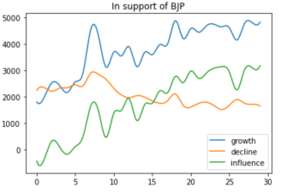
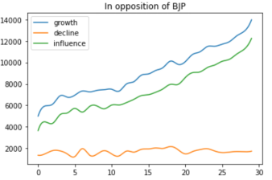
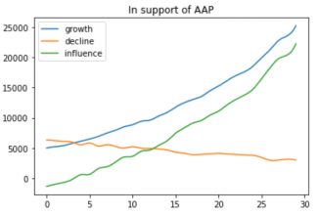
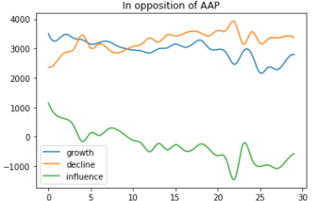
Results for Influence Analysis
Figure: 6) Growth and Decline in number of people over a period of 30 days and corresponding Influence in support of BJP
7) Growth and Decline in number of people over a period of 30 days and corresponding Influence in opposition of BJP
8) Growth and Decline in number of people over a period of 30 days and corresponding Influence in support of AAP
9) Growth and Decline in number of people over a period of 30 days and corresponding Influence in opposition of AAP
Fig .6
Fig .7
Fig .8
Fig .9

Slide 16
Conclusion
Tolerance level of people as well as Influence power of echo chambers both play a major role in election results.
AAP support group has high number of high tolerant people as well as high influencing power, resulted in a major victory in Delhi Election 2020.
BJP had more number of people with moderate level of tolerance hence it was more prone to loose its user base under the influence of others.

Slide 17
Future Scope
6.
Exploring more social networking platforms like koo or reddit.
More powerful NLP techniques (e.g., topic modelling) might enable more powerful analysis.
We will further try to come up with some real time visualization of such echo chambers.
Extended by adding a new parameter of unfriending between them.

Slide 18
References
7.
[1] Cinelli, Matteo, et al. "The echo chamber effect on social media." Proceedings of the National Academy of Sciences 118.9 (2021).
[2] Wang, Dandan, and Yuxing Qian. "Echo Chamber Effect in Rumor Rebuttal Discussions About COVID-19 in China: Social Media Content and Network Analysis Study." Journal of Medical Internet Research 23.3 (2021): e27009.
[3] Jiang, Julie, Xiang Ren, and Emilio Ferrara. "Social Media Polarization and Echo Chambers in the Context of COVID-19: Case Study." JMIRx Med 2.3 (2021): e29570.
[4] Luzsa, Robert, and Susanne Mayr. "False consensus in the echo chamber: Exposure to favorably biased social media news feeds leads to increased perception of public support for own opinions." Cyberpsychology: Journal of Psychosocial Research on Cyberspace 15.1 (2021).
[5] van Eck, Christel W., Bob C. Mulder, and Sander van der Linden. "Echo chamber effects in the climate change blogosphere." Environmental Communication 15.2 (2021): 145-152.
[6] Lada A Adamic and Eytan Adar. Friends and neighbors on the web. Social Networks, 25(3):211–230, 2003.
[7] Fabian Baumann, Philipp Lorenz-Spreen, Igor M. Sokolov, and Michele Starnini. Modeling echo chambers and polarization dynamics in social networks. Phys. Rev. Lett., 124:048301, Jan 2020.
[8] Elizabeth Dubois and Grant Blank. The echo chamber is overstated: the moderating effect of political interest and diverse media. Information, Communication & Society, 21(5):729–745, 2018.
[9] Tucker Evans and Feng Fu. Opinion formation on dynamic networks: identifying conditions for the emergence of partisan echo chambers. Royal Society Open Science, 5(10):181122, 2018.
[10] Seth Flaxman, Sharad Goel, and Justin M. Rao. Filter bubbles, echo chambers, and online news consumption. Public Opinion Quarterly, 80(S1):298–320, 2016.Reis JC, Correia A, Murai F, Veloso A, Benevenuto F. Supervised learning for fake news detection. IEEE Intelligent Systems. 2019 May 8;34(2):76-81.

Slide 19
References
7.
[11] Kiran Garimella, Gianmarco De Francisci Morales, Aristides Gionis, and Michael Mathioudakis. Political discourse on social media: Echo chambers, gatekeepers, and the price of bipartisanship. In Proceedings of the 2018 World Wide Web Conference, pages 913–922, 2018.
[12] R. Kelly Garrett. Echo chambers online?: Politically motivated selective exposure among Internet news users. Journal of Computer-Mediated Communication, 14(2):265–285, 2009.
[13] Daniel Geschke, Jan Lorenz, and Peter Holtz. The triple-filter bubble: Using agent-based modelling to test a meta-theoretical framework for the emergence of filter bubbles and echo chambers. British Journal of Social Psychology, 58(1):129–149, 2019.
[14] Andrew Guess, Benjamin Lyons, Brendan Nyhan, and Jason Reifler. Avoiding the echo chamber about echo chambers: Why selective exposure to like-minded political news is less prevalent than you think. Knight Foundation, 2018.
[15] K.H. Jamieson and J.N. Cappella. Echo Chamber: Rush Limbaugh and the Conservative Media Establishment. Oxford University Press, 2008.
[16] Lorien Jasny, Joseph Waggle, and Dana R Fisher. An empirical examination of echo chambers in US climate policy networks. Nat. Clim. Change, 5(8):782–786, 2015.
[17] Lada A Adamic and Eytan Adar. Friends and neighbors on the web. Social Networks, 25(3):211–230, 2003.
[18] J Ignacio Alvarez-Hamelin, Luca Dall’Asta, Alain Barrat, and Alessandro Vespignani. Large scale networks fingerprinting and visualization using the k-core decomposition. In Advances in Neural Information Processing Systems, pages 41–50, 2006.
[19] Lars Backstrom. Serving a billion personalized news feeds. In Proceedings of the Ninth ACM International Conference on Web Search and Data Mining, WSDM ’16, pages 469–469, New York, NY, USA, 2016. ACM.
[20] Lars Backstrom, Dan Huttenlocher, Jon Kleinberg, and Xiangyang Lan. Group formation in large social networks: Membership, growth, and evolution. In Proceedings of the 12th ACM SIGKDD International Conference on Knowledge Discovery and Data Mining, KDD ’06, pages 44–54, New York, NY, USA, 2006. ACM.

Slide 20
THANKS!

